Slide 1
Guidelines for Individualized Academic Curriculum and ITS Implementation for K-12 Students: a Resource Guide
ITS search tool
Search Criterion: -- Subject(s)/Domain -- -- Grade Range -- -- Tutor/Instruction Type --
Math
ELA
Science
History
English
Pre-K
Elementary
Middle
High
Core Curriculum
Complimentary
Catch-Up
 | School | Subject | Grade | Link | Add to
1 | Carnegie Learning | Math (Algebra) | Grade: 9 | https://www.carnegielearning.com/solutions/math
2 | School 2 | ELA | Grade: 7 | https://school2/this/link/will/not/work
3 | School 3 | ELA | Grade: 7 | https://school3/this/link/will/not/work
4 | IXL | Science (Chemistry) | Grade: 12 | https://www.ixl.com/science
5 | IXL | Social Studies | Grade: 2 | https://www.ixl.com/social-studies
6 | School 8 | Social Studies | Grade: 5 | https://school8/this/link/will/not/work
ITS Implementation Resource Page
< 1 2 3 4 >
CS6460: GIACII-K12 – Wireframe Prototype

Slide 2
CS6460: Educational Technology
Guidelines for Individualized Academic Curriculum and ITS Implementation for K-12 Students: a Resource Guide
Project Abstract
Intelligent Tutoring Systems (ITSs) and Individualized Education Plans (IEPs) have existed for decades in education. Researchers, through meta-analyses, have demonstrated the efficacy of ITS(s), irrespective of field of study (technical and non-technical subjects) in K-12 education (Ma et al, 2014). Modern ITS can evaluate and identifying a student’s emotional state and meta-cognitive skills, such as self-monitoring, self-explanation, etc (Conati, 2009). Since the 1970s, IEPs are, by law, implemented for students which are covered by IDEA (Individuals with Disabilities Education Act). An IEP is constructed annually by educators, administrators, and parents of special education students to define specific academic and functional goals per student.
Building on existing research and education practice, this site offers a resource for any individual constructing a curriculum for a K-12 student, looking to implement ITS(s) within a field of study. This site is built for parents / tutors / teachers and students to provide: (1) a background on IEP history and usage; (2) guidelines for planning a student’s curriculum with ITS(s) implemented; (3) a repository and search tool for commercially available ITS.
Site Overview
When building an individualized curriculum, use the guidelines as a reference.
Subpages included:
Guidelines
Background Information
Resources/Assessment
Research Log
Use the ITS Search page to find a solution.
Subpages included:
Guidelines
Background Information
Resources/Assessment
Research Log
CS6460: GIACII-K12 – Card Prototype
Home

Slide 3
CS6460: Educational Technology
Guidelines for Individualized Academic Curriculum and ITS Implementation for K-12 Students: a Resource Guide
Academic Planning
Background Information
Guidelines
Assessment Links
Research Log
ITS Search
Background Information
Search Tool
Full School List
Research Log
More
GIACII-K12 is…
GIACII-K12 is not…
Terminology
Additional Resources
Project Abstract
Intelligent Tutoring Systems (ITSs) and Individualized Education Plans (IEPs) have existed for decades in education. Researchers, through meta-analyses, have demonstrated the efficacy of ITS(s), irrespective of field of study (technical and non-technical subjects) in K-12 education (Ma et al, 2014). Modern ITS can evaluate and identifying a student’s emotional state and meta-cognitive skills, such as self-monitoring, self-explanation, etc (Conati, 2009). Since the 1970s, IEPs are, by law, implemented for students which are covered by IDEA (Individuals with Disabilities Education Act). An IEP is constructed annually by educators, administrators, and parents of special education students to define specific academic and functional goals per student.
Building on existing research and education practice, this site offers a resource for any individual constructing a curriculum for a K-12 student, looking to implement ITS(s) within a field of study. This site is built for parents / tutors / teachers and students to provide: (1) a background on IEP history and usage; (2) guidelines for planning a student’s curriculum with ITS(s) implemented; (3) a repository and search tool for commercially available ITS.
Site Overview
When building an individualized curriculum, use the guidelines as a reference.
Subpages included:
Guidelines
Background Information
Resources/Assessment
Research Log
Use the ITS Search page to find a solution.
Subpages included:
Guidelines
Background Information
Resources/Assessment
Research Log
CS6460: GIACII-K12 – Card Prototype
Home

Slide 4
Guidelines for Individualized Academic Curriculum and ITS Implementation for K-12 Students: a Resource Guide
ITS search tool
Search Criterion: -- Subject(s)/Domain -- -- Grade Range -- -- Tutor/Instruction Type --
Math
ELA
Science
History
English
Pre-K
Elementary
Middle
High
Core Curriculum
Complimentary
Catch-Up
 | School | Subject | Grade | Link | Add to
1 | Carnegie Learning | Math (Algebra) | Grade: 9 | https://www.carnegielearning.com/solutions/math
2 | School 2 | ELA | Grade: 7 | https://school2/this/link/will/not/work
3 | School 3 | ELA | Grade: 7 | https://school3/this/link/will/not/work
4 | IXL | Science (Chemistry) | Grade: 12 | https://www.ixl.com/science
5 | IXL | Social Studies | Grade: 2 | https://www.ixl.com/social-studies
6 | School 8 | Social Studies | Grade: 5 | https://school8/this/link/will/not/work
ITS Implementation Resource Page
< 1 2 3 4 >
CS6460: GIACII-K12 – Wireframe Prototype

Slide 5
Guidelines for Individualized Academic Curriculum and ITS Implementation for K-12 Students: a Resource Guide
Guidelines for Individualized Academic Curriculum
Requirement | Description
(a) General | Below is a proposed set of guidelines for parents, teachers, and tutors to use in the creation of a students' personalized academic curriculum (or individualized learning plan, or individualized curriculum outline, or personalized academic plan)
 | 1) A statement of the child's present levels of academic achievement and functional performance, including –
 | 2)
 | a) A statement of measurable annual goals, including academic and functional goals designed to –
 | i) Meet the child's needs to enable the child to be involved in and make progress in the general education curriculum; and
 | 3) A description of -
 | a) How the child's progress toward meeting the annual goals described in paragraph (2) of this section will be measured; and
 | b) When periodic reports on the progress the child is making toward meeting the annual goals (such as through the use of quarterly or other periodic reports, concurrent with the issuance of report cards) will be provided;
 | 4) A statement of the education and related services and supplementary aids and services, based on peer-reviewed research to the extent practicable, to be provided to the child, or on behalf of the child, and a statement of the program modifications or supports for school personnel that will be provided to enable the child –
 | a) To advance appropriately toward attaining the annual goals;
 | b) To be involved in and make progress in the general education curriculum in accordance with paragraph (a)(1) of this section, and to participate in extracurricular and other nonacademic activities; and
 | c) To be educated and participate with other children in the activities described in this section;
 | 6)
 | a) A statement to measure the academic achievement and functional performance of the child on State and districtwide assessments; and
 | ii) The particular alternate assessment selected is appropriate for the child; and
 | 7) The projected date for the beginning of the services and modifications described in paragraph (a)(4) of this section, and the anticipated frequency, location, and duration of those services and modifications.
(b) Transition services | Beginning not later than the first PAC (ILP/PAP/IAP/IAC/ICO) to be in effect when the child turns 16, or younger if determined appropriate by the PAC (ILP/PAP/IAP/IAC/ICO) Team, and updated annually, thereafter, the IEP must include -
 | (1) Appropriate measurable postsecondary goals based upon age-appropriate transition assessments related to training, education, employment, and, where appropriate, independent living skills; and
 | (2) The transition services (including courses of study) needed to assist the child in reaching those goals.
CS6460_Summer2022_TBPizzone
Individualized Curriculum Guidelines Page
CS6460: GIACII-K12 – Wireframe Prototype

Slide 6
Guidelines for Individualized Academic Curriculum and ITS Implementation for K-12 Students: a Resource Guide
Guidelines for Individualized Academic Curriculum
Requirement | Description
(a) General | Below is a proposed set of guidelines for parents, teachers, and tutors to use in the creation of a students' personalized academic curriculum (or individualized learning plan, or individualized curriculum outline, or personalized academic plan)
 | 1) A statement of the child's present levels of academic achievement and functional performance, including –
 | 2)
 | a) A statement of measurable annual goals, including academic and functional goals designed to –
 | i) Meet the child's needs to enable the child to be involved in and make progress in the general education curriculum; and
 | 3) A description of -
 | a) How the child's progress toward meeting the annual goals described in paragraph (2) of this section will be measured; and
 | b) When periodic reports on the progress the child is making toward meeting the annual goals (such as through the use of quarterly or other periodic reports, concurrent with the issuance of report cards) will be provided;
 | 4) A statement of the education and related services and supplementary aids and services, based on peer-reviewed research to the extent practicable, to be provided to the child, or on behalf of the child, and a statement of the program modifications or supports for school personnel that will be provided to enable the child –
 | a) To advance appropriately toward attaining the annual goals;
 | b) To be involved in and make progress in the general education curriculum in accordance with paragraph (a)(1) of this section, and to participate in extracurricular and other nonacademic activities; and
 | c) To be educated and participate with other children in the activities described in this section;
 | 6)
 | a) A statement to measure the academic achievement and functional performance of the child on State and districtwide assessments; and
 | ii) The particular alternate assessment selected is appropriate for the child; and
 | 7) The projected date for the beginning of the services and modifications described in paragraph (a)(4) of this section, and the anticipated frequency, location, and duration of those services and modifications.
(b) Transition services | Beginning not later than the first PAC (ILP/PAP/IAP/IAC/ICO) to be in effect when the child turns 16, or younger if determined appropriate by the PAC (ILP/PAP/IAP/IAC/ICO) Team, and updated annually, thereafter, the IEP must include -
 | (1) Appropriate measurable postsecondary goals based upon age-appropriate transition assessments related to training, education, employment, and, where appropriate, independent living skills; and
 | (2) The transition services (including courses of study) needed to assist the child in reaching those goals.
CS6460_Summer2022_TBPizzone
Academic Planning
Background Information
Guidelines
Assessment Links
Research Log
ITS Search
Background Information
Search Tool
Full School List
Research Log
More
GIACII-K12 is…
GIACII-K12 is not…
Terminology
Additional Resources
Individualized Curriculum Guidelines Page
CS6460: GIACII-K12 – Wireframe Prototype

Slide 7
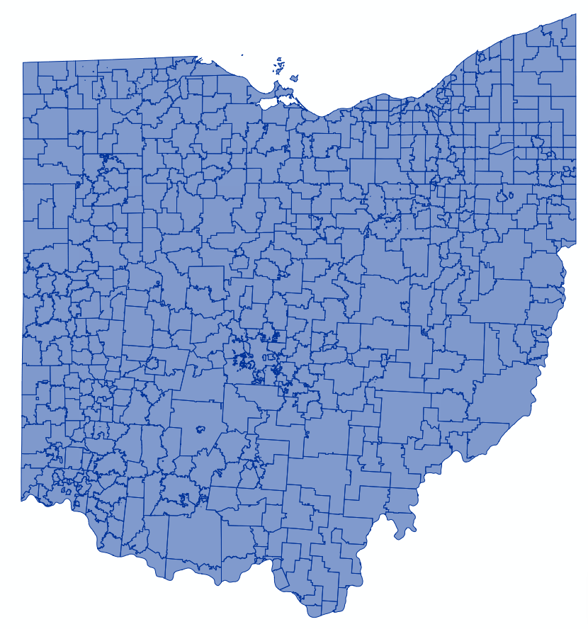
CSE 6242 Team #73: US School District Map Wireframe Prototype C
Comparison: by Time by State by County by City by District
Color by
Graduation Rate
Median SAT Scores
Median ACT Scores
College Matriculation Rate
--Select--
--Select--
New Mexico
Nevada
New York
Ohio
Oklahoma
Oregon
Pennsylvania
Rhode Island
South Carolina
New Mexico
Nevada
New York
Ohio
Oklahoma
Oregon
Pennsylvania
Rhode Island
South Carolina
--Data Set Select--
90-100
80-90
70-80
60-70
50-60
40-50
30-40
20-30
10-20
0-10
90-100
80-90
70-80
60-70
50-60
40-50
30-40
20-30
10-20
0-10
Time Range 1:
2010-2015
Time Range 2:
2015-2020
Time Interval: 10 Year 5 Year 2 Year
Time Interval: 10 Year 5 Year 2 Year

